Slide 1
Turn Based Combat Phase 2
The UI Design

Slide 2
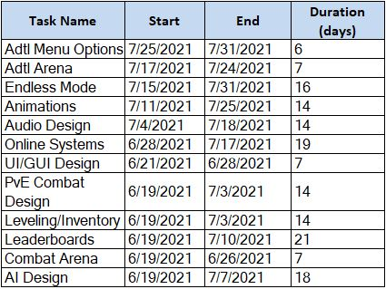
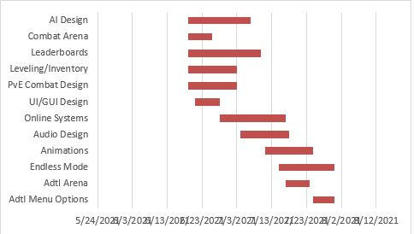
Gant Chart

Slide 3
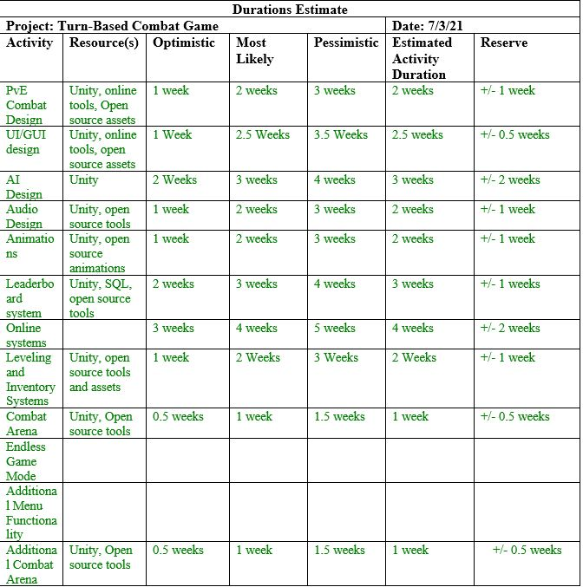
Gant Charts Cont..

Slide 4
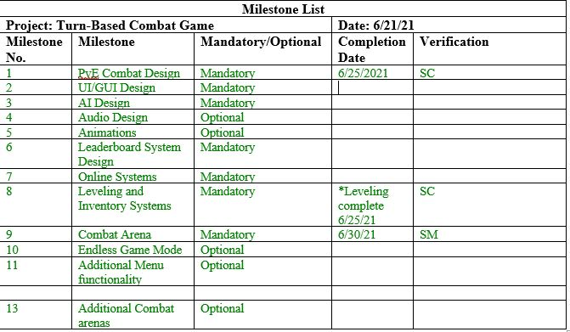
Milestones

Slide 5
System Design
The goal: To create a fun and feature rich turn-based combat game
System Overview: The game will be developed using the Unity game engine, the C# language and sprites/assets in the public domain.
Constraints: Limited knowledge of unity, and severely limited timeframe for game development

Slide 6
Roles and Responsibilities
Samuel Maynard: Project Manager and art direction
Shane Callaway: Assist with UI design and function, basic level combat, player and enemy stats, leveling, and balancing of combat
Thomas Mattei:
Alton Stillwell:
Kaitlyn Staats: Database design and integrating the database into unity.
Evan Colyer: AI programming, both for player characters and enemy non-player characters.

Slide 7
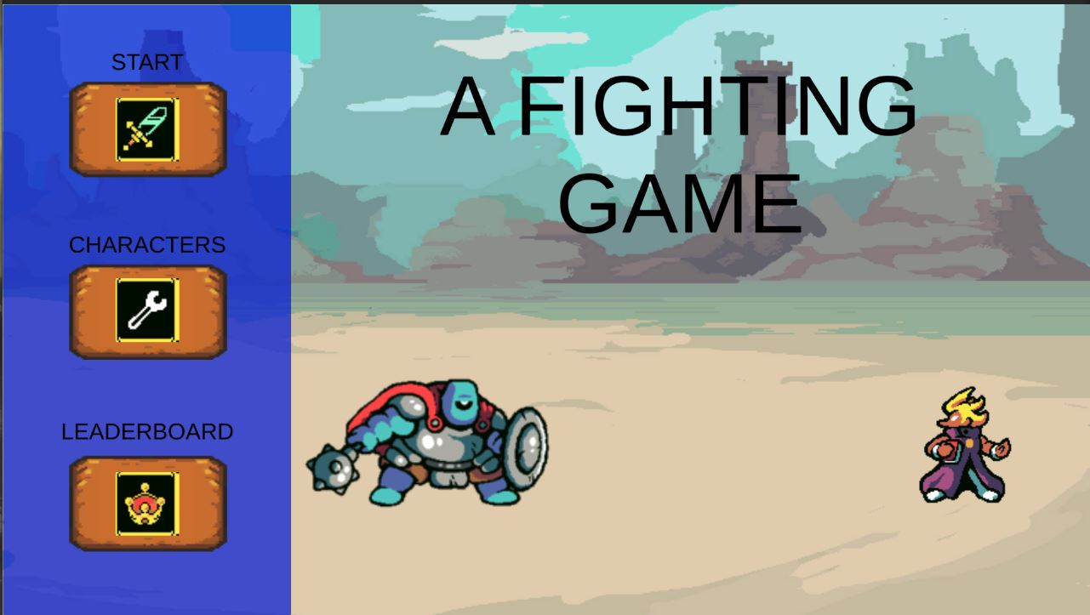
The Main Menu
Starts the combat
Takes player to the character screen
Takes player to the leaderboard screen

Slide 8
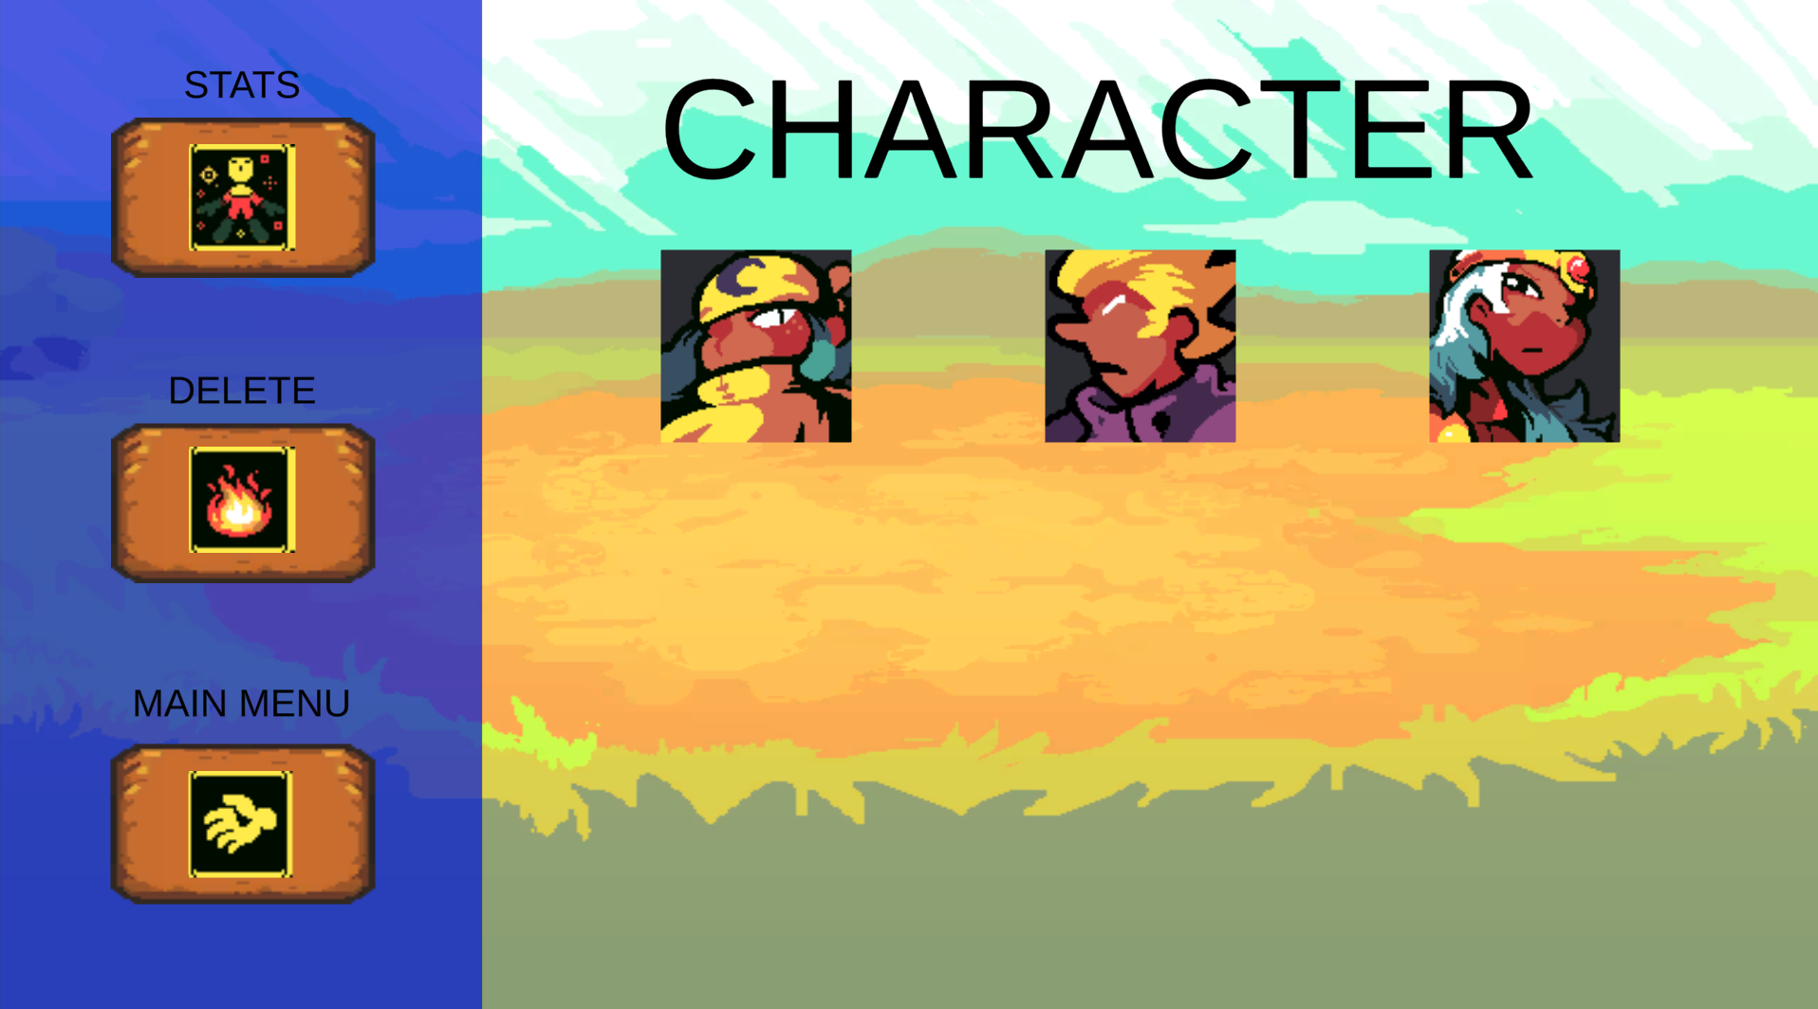
Character Screen
Character options and character selection will take place here
Displays a selected character’s stats
Deletes a character/save
Returns player to main menu

Slide 9
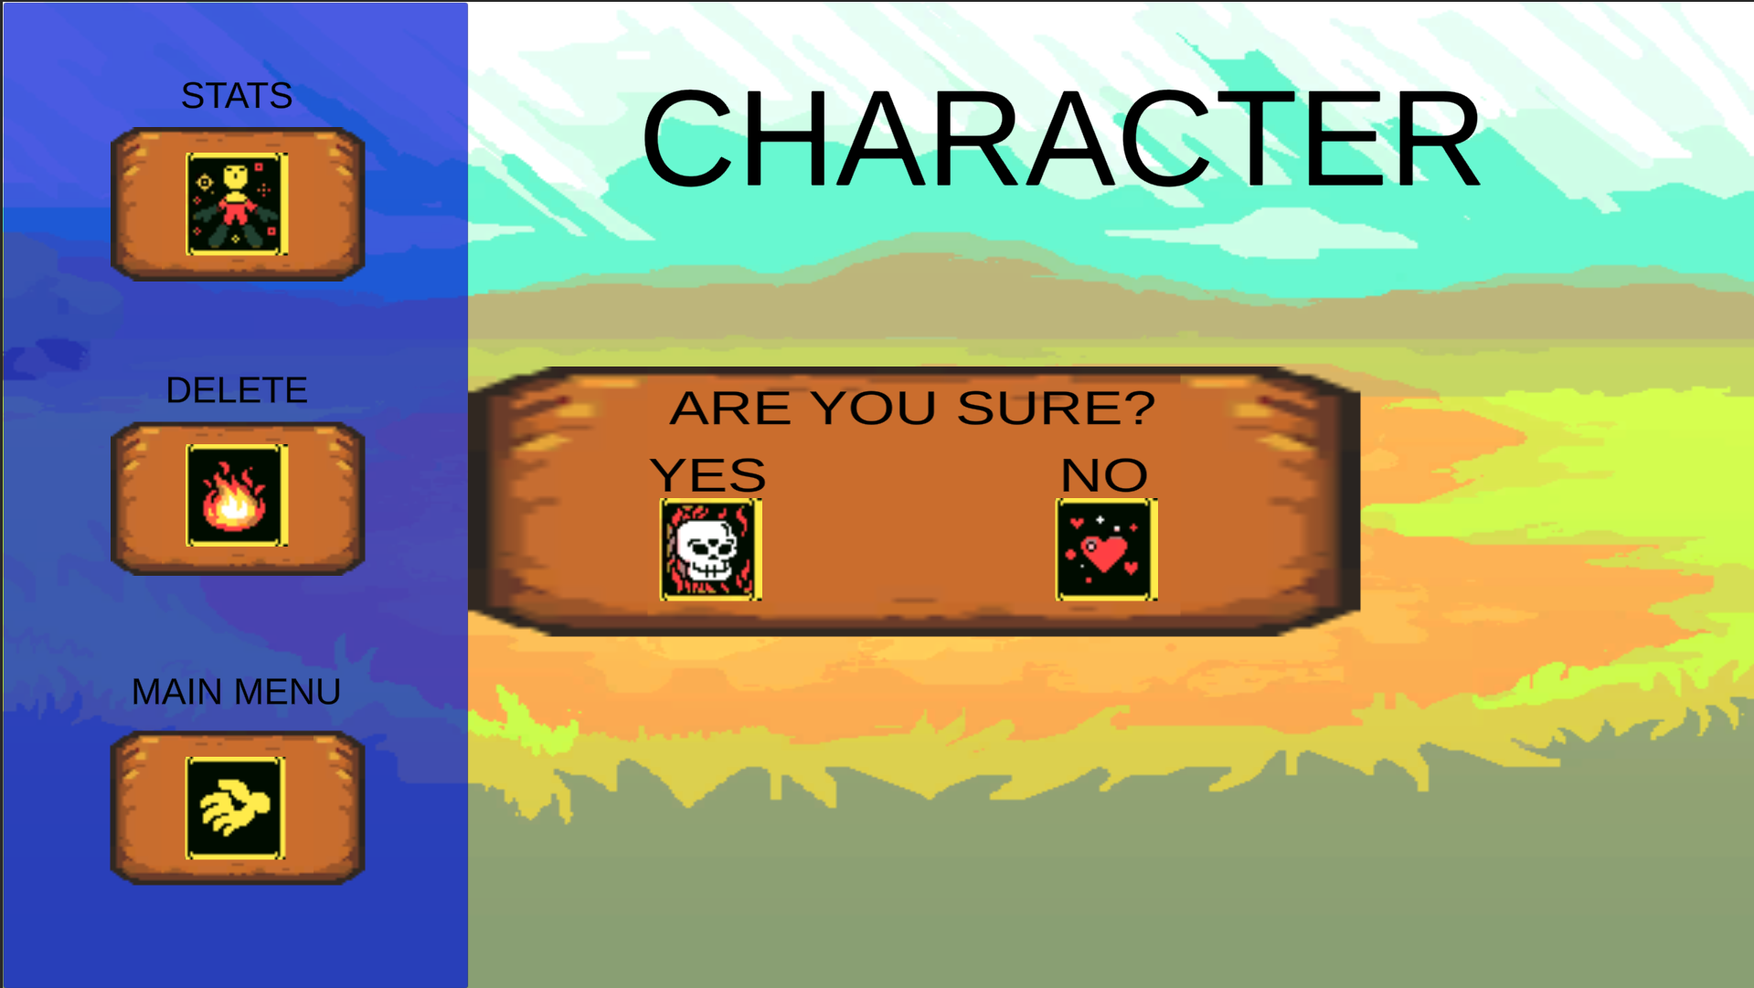
Character Screen
Example of the deletion dialogue box.

Slide 10
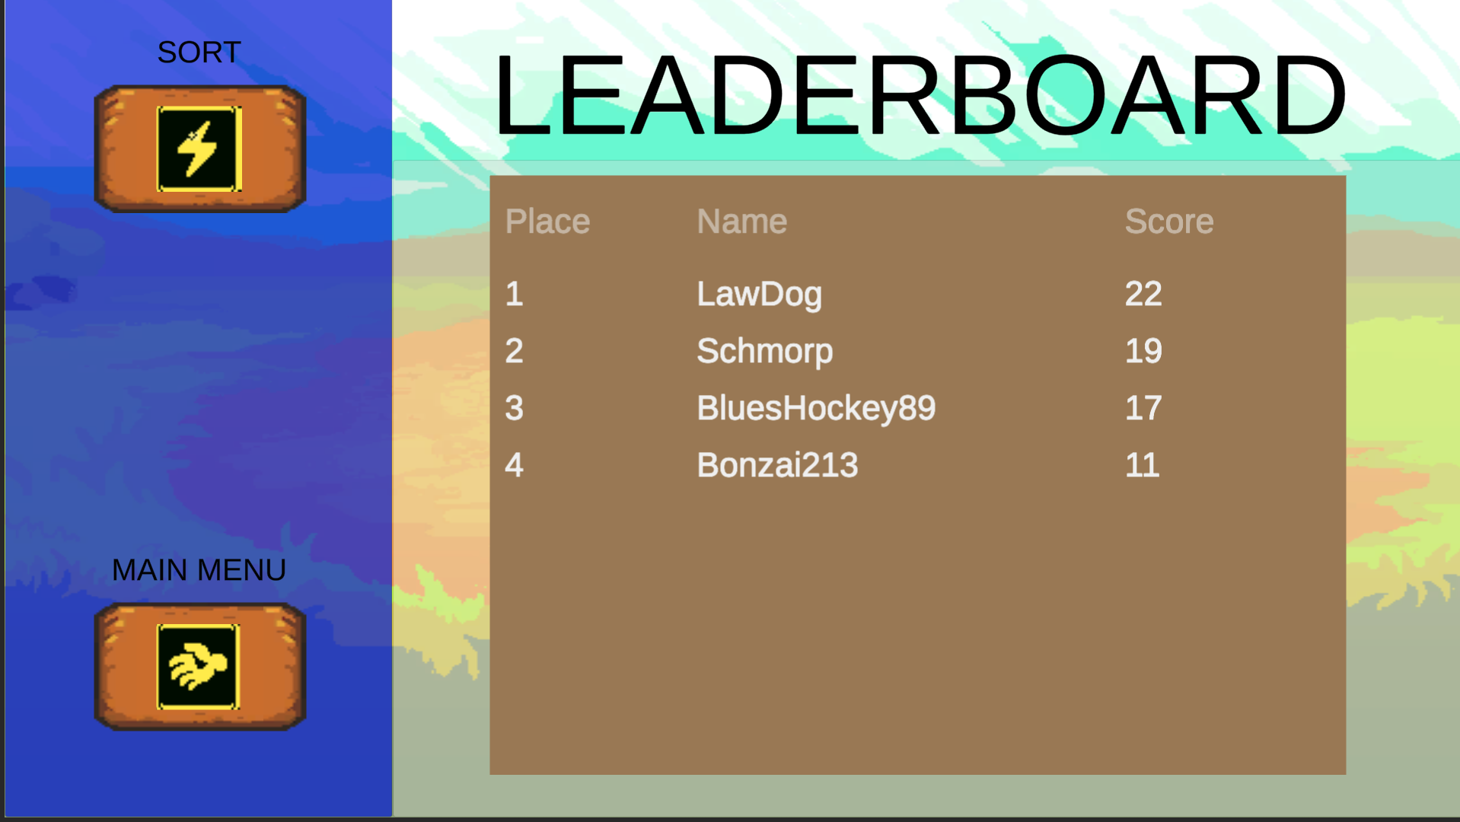
Leaderboard Screen
Leaderboard display pulled from Database will go here
Sorts and filters leaderboards
Returns player to main menu

Slide 11
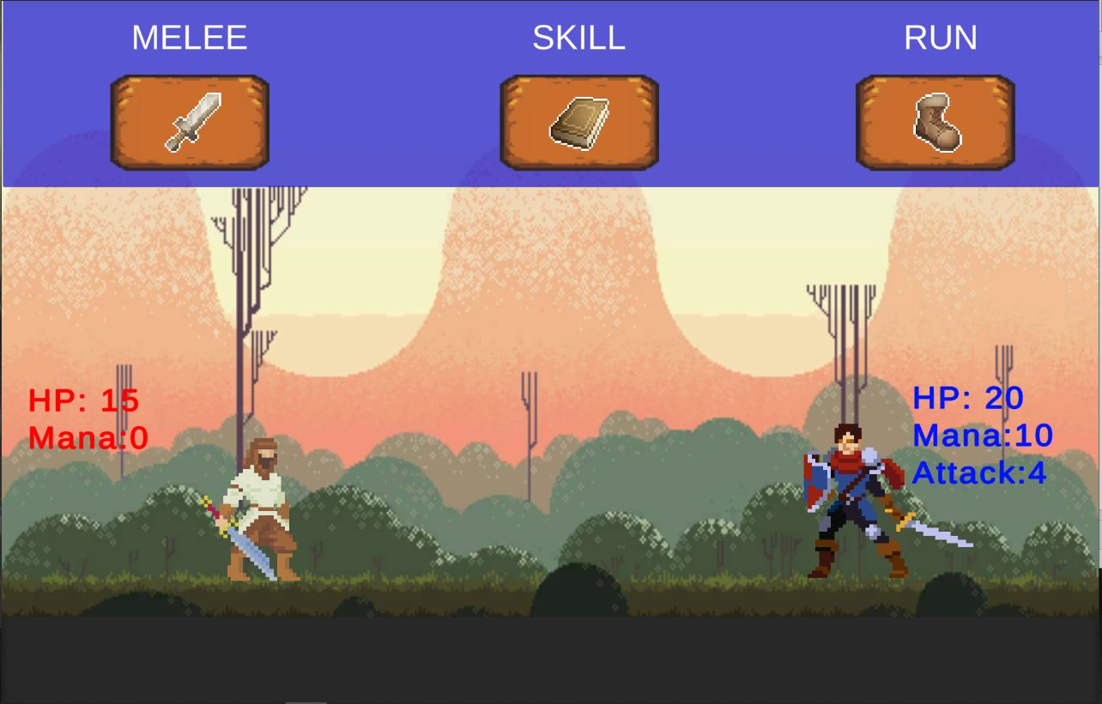
Combat Screen
Opens players skill menu
Exits combat and returns to main menu
Performs a basic melee attack
Enemy Stats
Character stats

Slide 12

Combat Screen (Skills Menu)
Re-opens main combat menu
Performs a magic attack using mana
Uses players ultimate using mana

